Slide 1
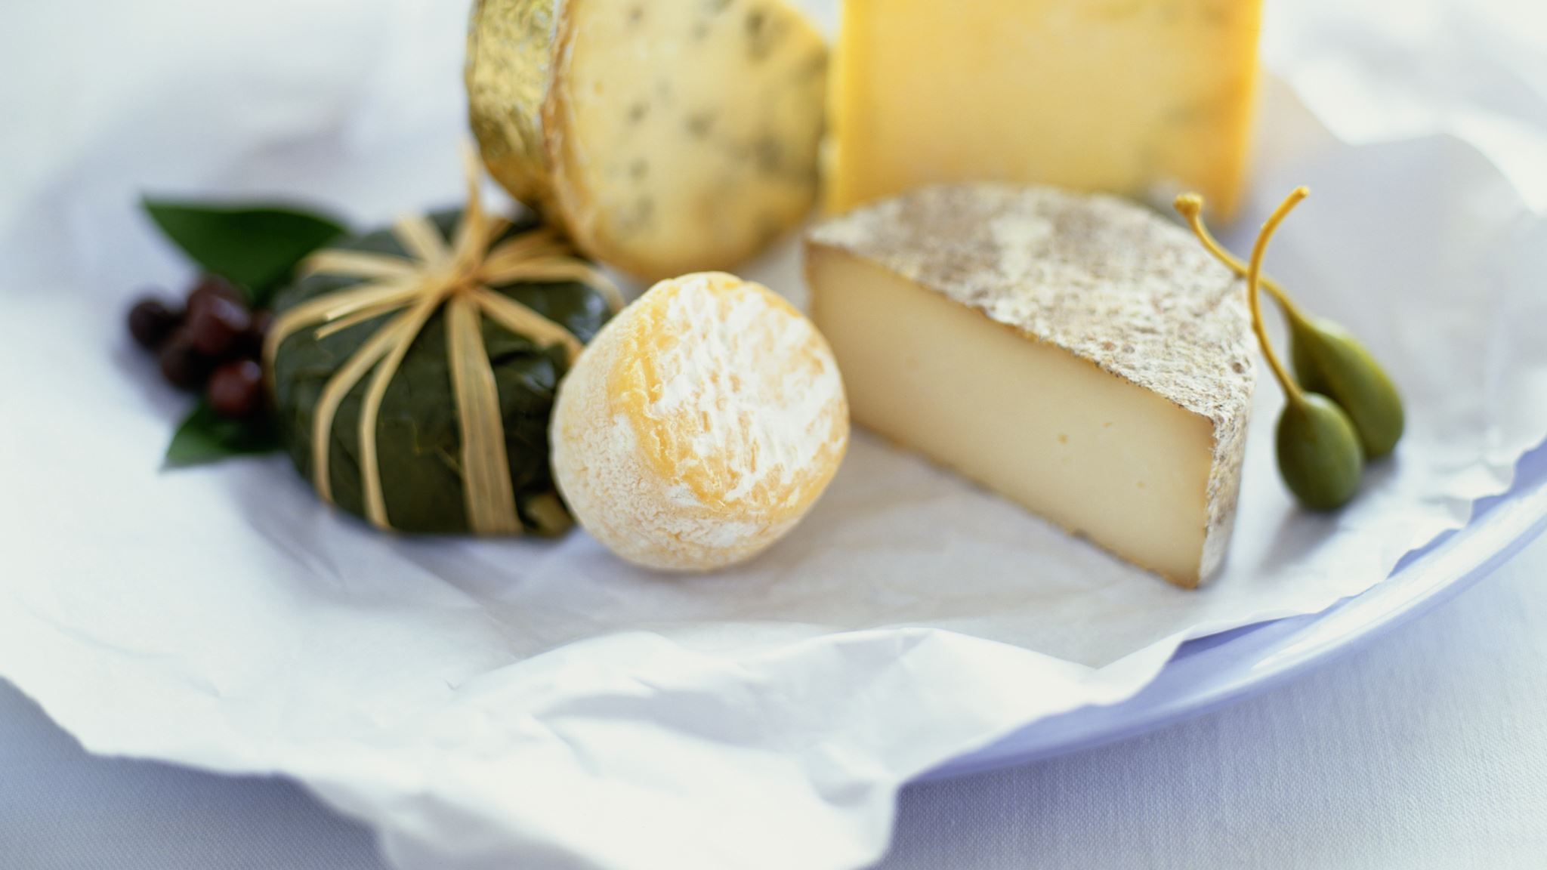
DSIF9 Capstone Project Cheese Recommender “Sweet Dreams are made of Cheese”
Ho Kit Fai

Slide 2
Problem Statement
The Cheese Shop (TCS) Pte. Ltd. is looking at growing their revenue further
3 key areas were identified – Digital Marketing, Events, and Upselling
Typically, prior to customer check out at retail stores, staff thru their observations of previous customer purchases would recommend items to customers to go with their existing basket. However, this is would not be consistent because full time staffs work on different shifts, and part time staffs may not be familiar with customer purchases
TCS engaged the author to build a recommender system that can be deployed at the Point of Sale terminal, and the website
Digital Marketing
Revenue
Recommender System
Upselling
Events

Slide 3


Data Collection
Physical retail stores transactions are exported from Vend Point of Sale System
Online store transactions are exported from BigCommerce System
Vend
Dataset
Big Commerce
This Photo by Unknown Author is licensed under CC BY-NC

Slide 4
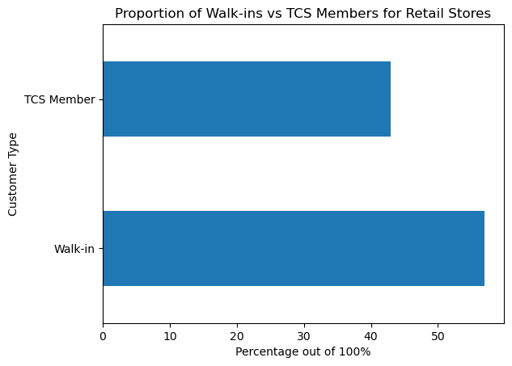
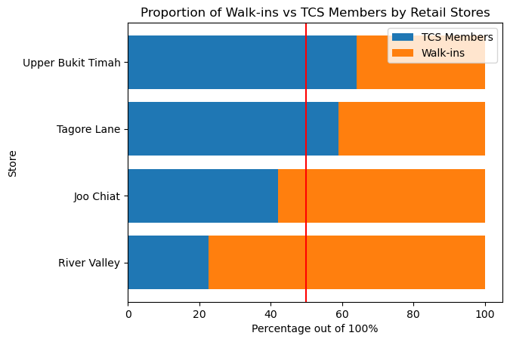
Exploratory Data Analysis – Retail Store
More than half of the visitors to the retail stores are Walk-Ins
The Upper Bukit Timah and Tagore Lane stores receives more member visits. This is likely due to the stores being closer to residential areas
Where as for Joo Chiat and River Valley, it is the other way around. This is likely due to the stores being closer to lifestyle destinations

Slide 5
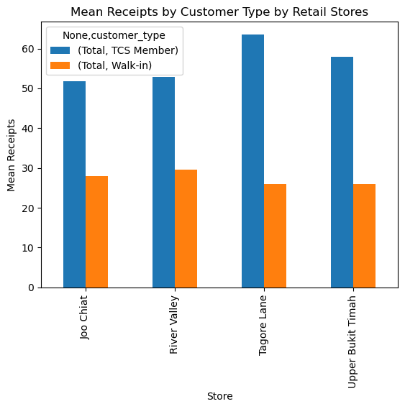
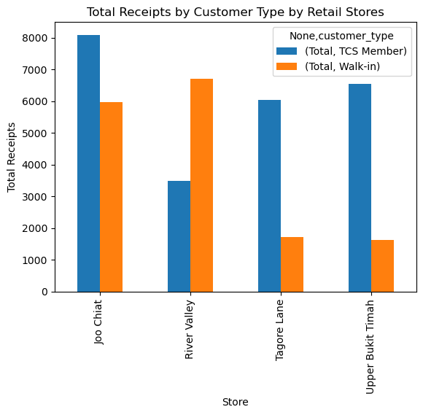
Exploratory Data Analysis – Retail Store and Online
Online Spend: 100$
The mean spend per receipt of members at Upper Bukit Timah and Tagore Lane are higher than that of Walk-ins as compared to Joo Chiat and River Valley
The mean spend per online transaction is around that of the Walk-ins
This is further confirmed by the total proportions of transactions

Slide 6
Exploratory Data Analysis – Retail Store and Online
Purchase Rank | Retail Store Walk-ins | Retail Store Members | Online Store
1 | Brie with Truffles | Brie with Truffles | Brie with Truffles
2 | Burrata d'Oro 200g | Greenheart Mini Heirloom Tomatoes 250g | Comte Janier (18 Mths)
3 | Plastic Bag | Burrata d'Oro 200g | Brillat Savarin with Truffles
4 | Mr Kneady Sourdough Medium | Peter's Yard Original Sourdough Crispbread | Double Cream Brie with Garlic & Herbs
5 | Greenheart Mini Heirloom Tomatoes 250g | The Fine Cheese Co. Walnut, Honey and Extra Vi... | Parmigiano Reggiano 36 months
6 | Parmigiano Reggiano 36 Months | Vacherousse D'Argental | Brie de Meaux AOC
7 | La Bufala Buffalo Mozzarella 100g | Jamón Serrano Ham 100g | Manchego - 12 months
8 | Applewood Smoked Cheddar | OG Kristal | Délice de Bourgogne
9 | Comte Janier (18 Mths) | La Bufala Buffalo Mozzarella 100g | Applewood Smoked Cheddar
10 | Comte Janier (30 mths) | Brie de Meaux AOC | Gruyère de Savoie
11 | Brie de Meaux AOC | Prima Donna | Camembert de Normandie (AOC)
12 | Jamón Serrano Ham 100g | Mr Kneady Sourdough Medium | Gouda with Truffles
13 | Pecorino Romano | Coppa di Parma 100g | Pecorino Moliterno with Truffles
14 | Barney Jack's Jelly Babies | Applewood Smoked Cheddar | Brie with Cranberries
15 | Vacherousse D'Argental | Plastic Bag | Cambozola Black Label
16 | Double Cream Brie with Garlic & Herbs | San Francesco Prosciutto Crudo 100g | Comte Extra Mature (24 Months)
17 | OG Kristal | Comte Janier (30 mths) | Pecorino Romano
18 | Coppa di Parma 100g | Gouda with Truffles | Mimolette (22 months)
19 | Rosette duc de Coise Sliced 100g | Comte Janier (18 Mths) | Janier Raw Cream Butter (Semi-Salted)
20 | Gruyere de Savoie | Delice de Bourgogne with Pineapples | Comte Janier 30 Months
While the expenditure of members more than double of that of walk-ins, it can be seen that the Top 20 items which they purchase are generally similar
The items for the online store is quite different from that in the physical retail stores
Online Store has more soft cheese sold
Walk-ins buy more plastic bag

Slide 7
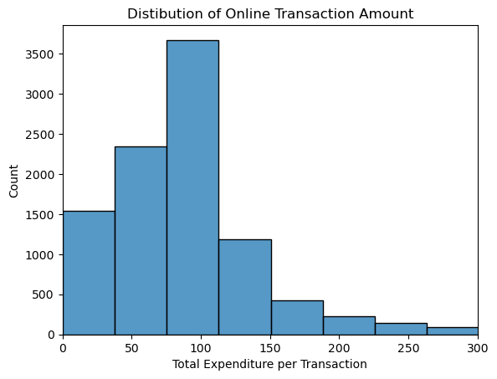
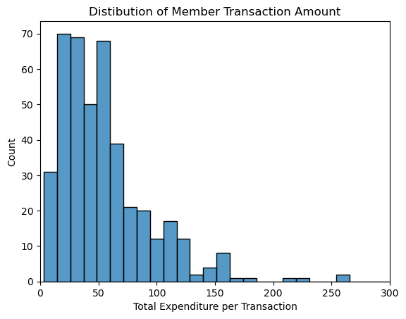
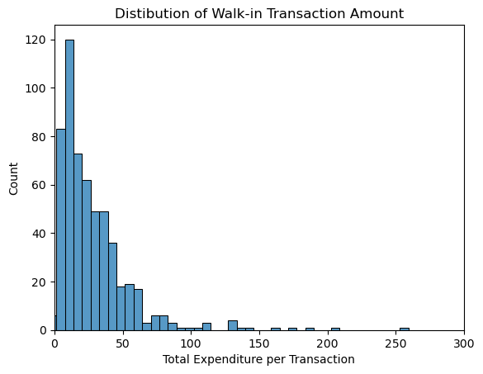
Exploratory Data Analysis – Retail Store and Online
Generally, the median online transactions is 100$, this may be attributed to the minimum 100$ order for free delivery
Members’ peak count of transaction is around 25$ to 50$, with no clear median
Walk-in customers’ peak count of transaction is around 20$

Slide 8

Modelling
Collaborative Filter
Content-based Filter
Collaborative Filter was chosen over Content-based Filter
The combined retail and online transactions were fed into the collaborative filter algorithm
As there is no explicit ratings for the product purchased, the implicit feedback – quantities of products purchased is the input which the collaborative filter will take in
Combined Retail & Online Transaction
Recommendations
Notes:
We deploy a collaborative filter because we want to recommend what other similar users have purchase in the past (sort of like “crowd sourced” ideas). It is more advantageous as compared to a content based filter which relies more on ”item feature”, which is a lot more laborious to generate, and content based filter may keep recommending the same category of items

Slide 9
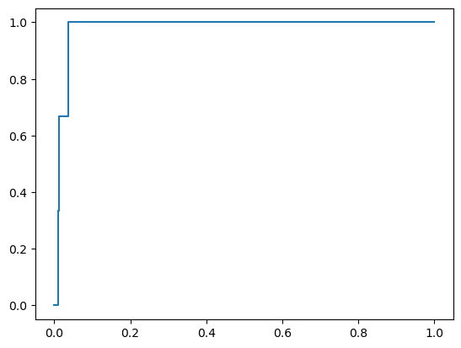
Evaluation
The model achieved a mean AUC Score of 0.853
However, a model is good in the eyes of the non-technical user, only if it makes sense
True Positive Rate
False Positive Rate
Notes:
We deploy a collaborative filter because we want to recommend what other similar users have purchase in the past (sort of like “crowd sourced” ideas). It is more advantageous as compared to a content based filter which relies more on ”item feature”, which is a lot more laborious to generate, and content based filter may keep recommending the same category of items

Slide 10
Evaluation
Transaction: 146471
Purchased Items | Recommended Purchase
Butcher Box Grain Fed Beef Mince 500g | Burrata d'Oro 200g
Alp Blossom | Cottage Delight Classic Italian Breadsticks
Chiriboga Blue | The Fine Cheese Co. Rosemary and Extra Virgin Crackers
Gorgonzola Piccante | Greenheart Mini Heirloom Tomatoes 250g
Coppa di Parma 100g | Mr Kneady Sourdough Medium
The model achieved a mean AUC Score of 0.853
However, a model is good in the eyes of the non-technical user, only if it makes sense
Transaction: 146471 is likely whipping up a family burger meal
Notes:
We deploy a collaborative filter because we want to recommend what other similar users have purchase in the past (sort of like “crowd sourced” ideas). It is more advantageous as compared to a content based filter which relies more on ”item feature”, which is a lot more laborious to generate, and content based filter may keep recommending the same category of items

Slide 11
Evaluation
Transaction: TG25078
Purchased Items | Recommended Purchase
OSCAS Super Woofs 2023 Calendar | Cottage Delight Classic Italian Breadsticks
Rosette duc de Coise Sliced 100g | Greenheart Mini Heirloom Tomatoes 250g
Coppa di Parma 100g | Mr Kneady Sourdough Medium
Speck Campiglio 100g | Plastic Bag
Mr Filbert's Mixed Nuts Italian Black Truffle | Snowdonia Truffle Trove Extra Mature Cheddar
Mr Filbert's Mixed Nuts Simply Sea Salt | Granny Gothards Luxury Ice Cream Lavender Blossom
The Fine Cheese Co. Walnut, Honey and Extra Virgin Crackers | Jamón Serrano Ham 100g
Peter's Yard Original Sourdough Crispbread | Outback Pie Co. Prime Beef Pie
Burrata d'Oro 200g | San Pellegrino Pomegranate & Orange
Vacherousse D'Argental | Barney Jack's Liquorice Allsorts
Brie with Truffles
Gouda with Caramel
The model achieved a mean AUC Score of 0.853
However, a model is good in the eyes of the non-technical user, only if it makes sense
Transaction: TG25078 is likely having a party at home
Notes:
We deploy a collaborative filter because we want to recommend what other similar users have purchase in the past (sort of like “crowd sourced” ideas). It is more advantageous as compared to a content based filter which relies more on ”item feature”, which is a lot more laborious to generate, and content based filter may keep recommending the same category of items

Slide 12



Recommendations, Conclusion, Further Work
Discounts/deals can be deployed to increase the revenue from Walk-in Customers
As members and walk-ins may require preplanning of their day activities prior to shopping at TCS, a “Deliver to your Home within 4 hours” service could be introduced to encourage these customers to purchase items (such as soft cheese) that they otherwise would not purchase
Propose TCS to synergise their stock system (Vend POS and BigCommerce) into one single system to enable better and repeatable data analysis in the future
The Recommender System can be deployed into Vend POS
The Recommender System needs to be compared with BigCommerce’s RecCommerce (Recommender System), prior to deployment onto Big Commerce
Hypothesis testing on the performance of the recommender system in 3 months to confirm customer conversion

